Slide 1
Mueller polarimetry through an optical fiber
¹J. Vizet, ¹S. Manhas, ²S. Deby, ²J.C. Vanel, ²A. De Martino, ¹D. Pagnoux
¹ Institut de recherche XLIM, UMR CNRS 7252,
Université de Limoges, Faculté des Sciences et Techniques, Limoges, France
² LPICM, UMR CNRS 7647,
Ecole Polytechnique, Palaiseau, France

Slide 2
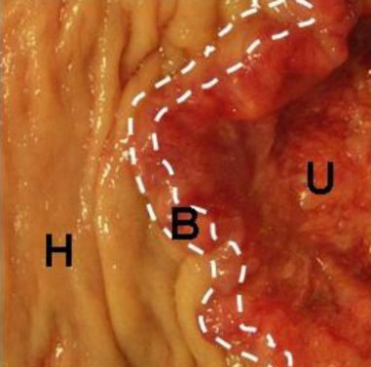
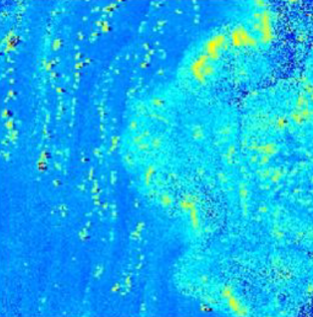
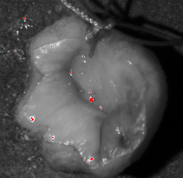
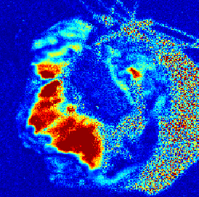
Why polarimetric imaging of biological tissues ?
Mueller polarimetry
M : 4x4 Mueller matrix
Diattenuation
(linear and circular)
Retardance
(linear and circular)
Depolarization
Applied to biological tissues imaging …
Colon cancer [1]
Depolarization
Cervix cancer [2]
Retardance
A
A
H
H
H
A
H : Healthy , A : Abnormal
[1] : “Ex-vivo characterization of human colon cancer by Mueller polarimetric imaging”. Angelo Pierangelo et al., Optics express 1593, Vol. 2, No. 9 (2011)
[2] : “Imagerie polarimétrique pour le diagnostic du cancer du col utérin” A. Pierangelo et al., Journées d’imagerie non-conventionnelle (2013)

Slide 3
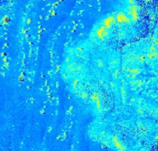
Problematic of the use of Mueller imaging systems
Polarimetric imaging of biological tissues
Imaging
reconstruction
system
Light source
Polarimetric image
of biological sample
Detector
PSG
PSA
PSG : Polarization states generator
PSA : Polarization states analyzer
Probing
Polarization
State
Backscattered
Polarization state
Biological
Sample
WELL KNOWN
DIRECTLY ANALYSED
Drawbacks :
Need of biopsies
Time consuming

Slide 4
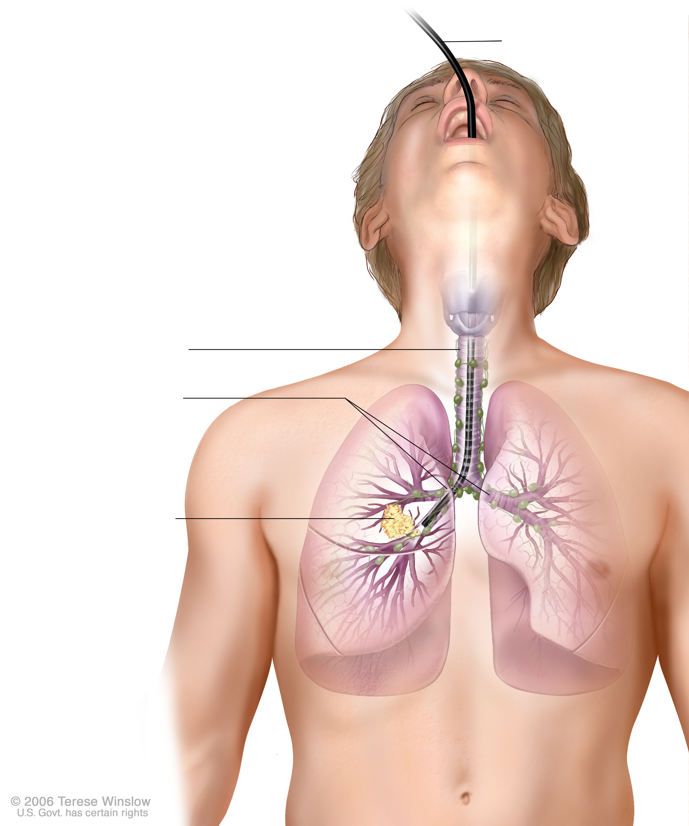
Why polarimetric imaging of biological tissues through an endoscopic fiber ?
Polarization analysis system
Optical fiber (endoscope)
Light source
PSG
PSA
Detector
Trachea
Bronchi
Abnormal tissue
Image reconstruction system
Advantages :
In vivo in situ observations
Possibility of early detection of diseases
Less biopsies

Slide 5
Why polarimetric imaging of biological tissues through an endoscopic fiber ?
Polarization analysis system
Optical fiber (endoscope)
Light source
PSG
PSA
Detector
Trachea
Bronchi
Abnormal tissue
Image reconstruction system
Problem :
Optical fiber modifies polarization states in a uncontrolled manner
Probing AND backscattered states are UNKNOWN

Slide 6
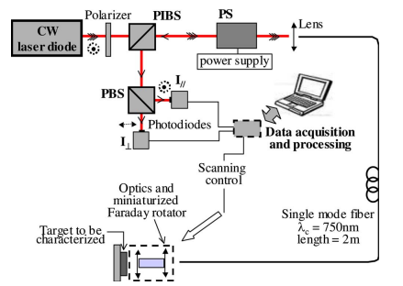
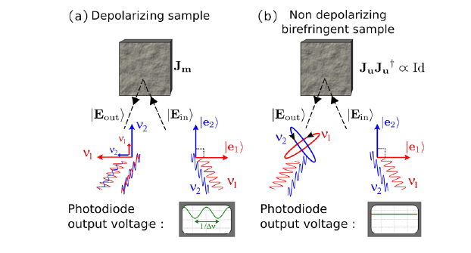
Existing techniques for polarimetric endoscopic characterizations
Compensation of fiber birefringence by the use of a Faraday rotator [3] :
Advantages :
Linear retardance measurement of samples
Drawback :
Measurement can be slow
Orthogonality breaking of two waves coming from a single laser [4] :
Advantages :
Measurement insensitive to propagation in fiber
No specific component is needed near sample
Drawback :
Both depolarization and diattenuation
cause orthogonality breaking
[3] : “Fiber-optic device for endoscopic polarization imaging”. J. Desroches et al, Opt. Lett. 34, 3409-3411 (2009)
[4] : “Depolarization Remote Sensing by Orthogonality Breaking” . J. Fade and M. Alouini, PRL 109, 043901 (2012)

Slide 7
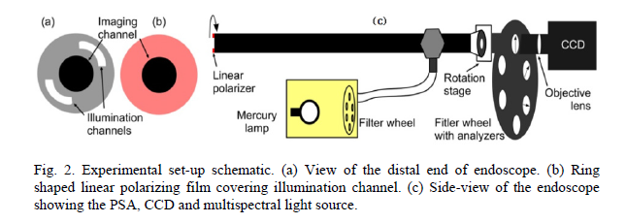
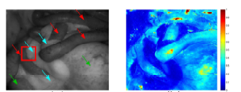
Existing techniques to do polarimetric endoscopic characterizations
Polarimetric analysis through a rigid laparoscope [5] :
Rat abdomen
Raw image
Depolarization
image
Advantages :
Large field of view (5,5 x 5,5cm)
Avoid complicated miniaturizations
Drawbacks :
PSG states generated by rotation of the laparoscope
Spatial stability problems
3x3 Mueller matrices obtained
[5] : “Narrow band 3x3 Mueller polarimetric endoscopy”. Ji Qo et al, Opt. Express, 14, 2433-2449 (2013)

Slide 8
Summary
How to find Mueller matrix of a sample through an optical fiber ?
2) Polarimetric characteristics measurements of calibrated samples
Polarimetric characteristics measurement of a waveplate
Linear phase retardance measurement
Linear diattenuation measurement
Polarimetric characteristics measurement of a linear retarder associated with
a linear diattenuator
4) Alternative technique to avoid fiber contribution
5) Conclusion

Slide 9
Summary
How to find Mueller matrix of a sample through an optical fiber ?
2) Polarimetric characteristics measurements of calibrated samples
Polarimetric characteristics measurement of a waveplate
Linear phase retardance measurement
Linear diattenuation measurement
Polarimetric characteristics measurement of a linear retarder associated with
a linear diattenuator
4) Alternative technique to avoid fiber contribution
5) Conclusion

Slide 10
How to find Mueller matrix of a sample through an optical fiber ? - Fiber Mueller matrix
1
3
2
4
CW laser diode @638nm
PSG
PSA
1 : Injection lens
2 : Collimation lens
3 : Single mode fiber
4 : Detection with photodiode and data processing
Measured matrix of
a single mode fiber
1 | 0 | 0.001 | 0.004
0.007 | -0.712 | 0.696 | -0.093
0.003 | -0.289 | -0.173 | 0.925
-0.003 | 0.632 | 0.691 | 0.337
0,04%
Diattenuation
Lu & Chipman
decomposition [6]
0,67%
Depolarization
Retardance
Total : 2,46 rads
Linear : 1,23 rads
[6] : “Interpretation of Mueller matrices based on polar decomposition”. S.Y. Lu and R. A. Chipman, JOSA A, Vol. 13, Issue 5, pp. 1106-1113 (1996)

Slide 11
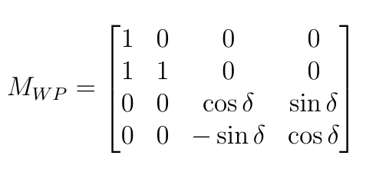
How to find Mueller matrix of a sample through an optical fiber ? - Mathematical explanation
Waveplate with δ retardance
y
Fast
Slow
x
Oriented waveplate with δ retardance
y
Fast
θ
x
Slow

Slide 12
How to find Mueller matrix of a sample through an optical fiber ? - Mathematical explanation
Input side
Output side
Slow
« Endoscopic » optical fiber
Fast
Fast
Slow

Slide 13
How to find Mueller matrix of a sample through an optical fiber ? - Experimental setup
1
2
3
4
5
6
7
CW laser diode @638nm
PSG
PSA
1 : Polarization insensitive beamsplitter cube
2 : Injection lens
3 : Single mode fiber
4 : Collimation lens
5 : Switchable mirror
6 : Sample
7 : Mirror
8 : Detection with photodiode and data processing
8
How to deduce the polarimetric response of sample through fiber ?
Two measurements
Fiber
Fiber + sample

Slide 14
How to find Mueller matrix of a sample through an optical fiber ? - Mathematical explanation
Switchable mirror ON
Switchable mirror OFF
Beam exiting
the fiber
Beam exiting
the fiber
Sample
Sample
Mirror
Mirror
Towards fiber
and analysis
Towards fiber
and analysis
Switchable mirror
Switchable mirror
Backward
Forward
θ₁
Backward
Forward
δ

Slide 15
How to find Mueller matrix of a sample through an optical fiber ?
1
2
3
4
5
6
7
CW laser diode @638nm
PSG
PSA
8
Experimental validation
with different types of samples :
Linear retarders (fixed of variable)
Diattenuators
Association of components
1 : Polarization insensitive beamsplitter cube
2 : Injection lens
3 : Single mode fiber
4 : Collimation lens
5 : Switchable mirror
6 : Sample
7 : Mirror
8 : Detection with photodiode and data processing

Slide 16
Summary
How to find Mueller matrix of a sample through an optical fiber ?
2) Polarimetric characteristics measurements of calibrated samples
Polarimetric characteristics measurement of a waveplate
Linear phase retardance measurement
Linear diattenuation measurement
Polarimetric characteristics measurement of a linear retarder associated with
a linear diattenuator
4) Alternative technique to avoid fiber contribution
5) Conclusion

Slide 17
Measurements of calibrated samples : Polarimetric characteristics of a waveplate
λ/8 @633nm waveplate
y
Beam exiting the fiber
x
z
Mirror
Towards fiber and analysis
Switchable mirror
y
λ/8 @633nm waveplate
rotation
z
x
λ/8 retardance @638nm :
Single pass : 44,64°
Double pass : 89,29°

Slide 18
Measurements of calibrated samples : Polarimetric characteristics of a waveplate
@638nm

Slide 19
Summary
How to find Mueller matrix of a sample through an optical fiber ?
2) Polarimetric characteristics measurements of calibrated samples
Polarimetric characteristics measurement of a waveplate
Linear phase retardance measurement
Linear diattenuation measurement
Polarimetric characteristics measurement of a linear retarder associated with
a linear diattenuator
4) Alternative technique to avoid fiber contribution
5) Conclusion

Slide 20
Measurements of calibrated samples : Linear phase retardance of a Babinet-Soleil compensator
Babinet-Soleil Compensator :
tunable linear retarder
Beam exiting the fiber
Mirror
Towards fiber and analysis
Switchable mirror

Slide 21
Summary
How to find Mueller matrix of a sample through an optical fiber ?
2) Polarimetric characteristics measurements of calibrated samples
Polarimetric characteristics measurement of a waveplate
Linear phase retardance measurement
Linear diattenuation measurement
Polarimetric characteristics measurement of a linear retarder associated with
a linear diattenuator
4) Alternative technique to avoid fiber contribution
5) Conclusion

Slide 22
Measurements of calibrated samples : Linear diattenuation measurement
Tilted glass plate with α angle :
tunable linear diattenuator
Beam exiting the fiber
α
Mirror
Towards fiber and analysis
Switchable mirror

Slide 23
Summary
How to find Mueller matrix of a sample through an optical fiber ?
2) Polarimetric characteristics measurements of calibrated samples
Polarimetric characteristics measurement of a waveplate
Linear phase retardance measurement
Linear diattenuation measurement
Polarimetric characteristics measurement of a linear retarder associated with
a linear diattenuator
4) Alternative technique to avoid fiber contribution
5) Conclusion

Slide 24
Experimental validation : Association of components
Babinet-Soleil Compensator :
tunable linear retarder : FAST AXIS SET AT 0°
Beam exiting the fiber
α
Mirror
Towards fiber and analysis
Tilted glass plate with α angle :
Fixed linear diattenuator (≈17%)
Switchable mirror

Slide 25
Experimental validation : Association of components
Babinet-Soleil Compensator :
tunable linear retarder : FAST AXIS SET AT 45°
Beam exiting the fiber
α
Mirror
Towards fiber and analysis
Tilted glass plate with α angle :
Fixed linear diattenuator (≈35%)
Switchable mirror

Slide 26
Summary
How to find Mueller matrix of a sample through an optical fiber ?
2) Polarimetric characteristics measurements of calibrated samples
Polarimetric characteristics measurement of a waveplate
Linear phase retardance measurement
Linear diattenuation measurement
Polarimetric characteristics measurement of a linear retarder associated with
a linear diattenuator
4) Alternative technique to avoid fiber contribution
5) Conclusion

Slide 27
Alternative solution to the switchable mirror ?
1
3
9
5
6
CW laser diode @660nm
8
PSG
2
4
CW laser diode @638nm
PSA
7
638nm
660nm
1 : Polarization insensitive beamsplitter cube
2 : Injection lens
3 : Single mode fiber
4 : Collimation lens
5 : Sample
6 : Mirror
7 : Detection with photodiode and data processing
8 : Dichroic mirror (45°)
9 : Dichroic mirror (straight)
638nm
8
7
660nm
6
638nm : characterization of fiber
660nm : characterization of fiber + sample
Challenge : deduce the linear retardance of fiber @660nm from 638nm

Slide 28
Conclusion
Conclusion
Capability of our method to overcome the fiber contribution
Several polarimetric characteristics of samples are accessible :
Rotation and retardance induced by linear retarders
Linear diattenuation
Circular diattenuation
Perspectives
Implementation of the chromatic method
Depolarization measurement of biological samples

Slide 29
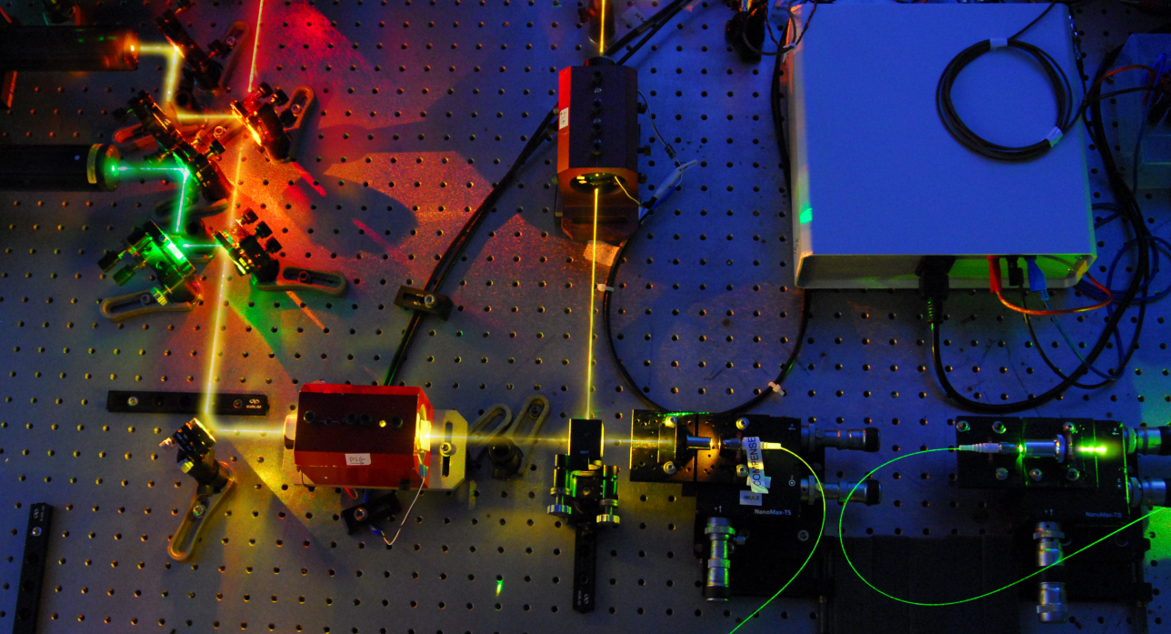
We are grateful to the french ANR for its financial support
to this work, through the IMULE project
Thanks to the workshop organizers &
thank you for your attention

